Slide 1
Advanced Frontend Development
ES6 Features
Task 1
Compiled by Yusuf Abu-safyan
https://github.com/Sufyan-codes/FlexiSaf-Internship.git

Slide 2
scope
The scope of a variable is the region of your program source code in which it is defined. A global variable has global scope; it is defined everywhere in your JavaScript code. On the other hand, variables declared within a function are defined only within the body of the function. They are local variables and have local scope. Function parameters also count as local variables and are defined only within the body of the function

Slide 3
Let, const
Let and const are both key words allowing us to define the scope and type of varible to use.
Let allows reassignment while const means the variable does not change
Let name = ‘name’ //name can be reassigned
Const name = ‘name’ /name can not be reassigned

Slide 4
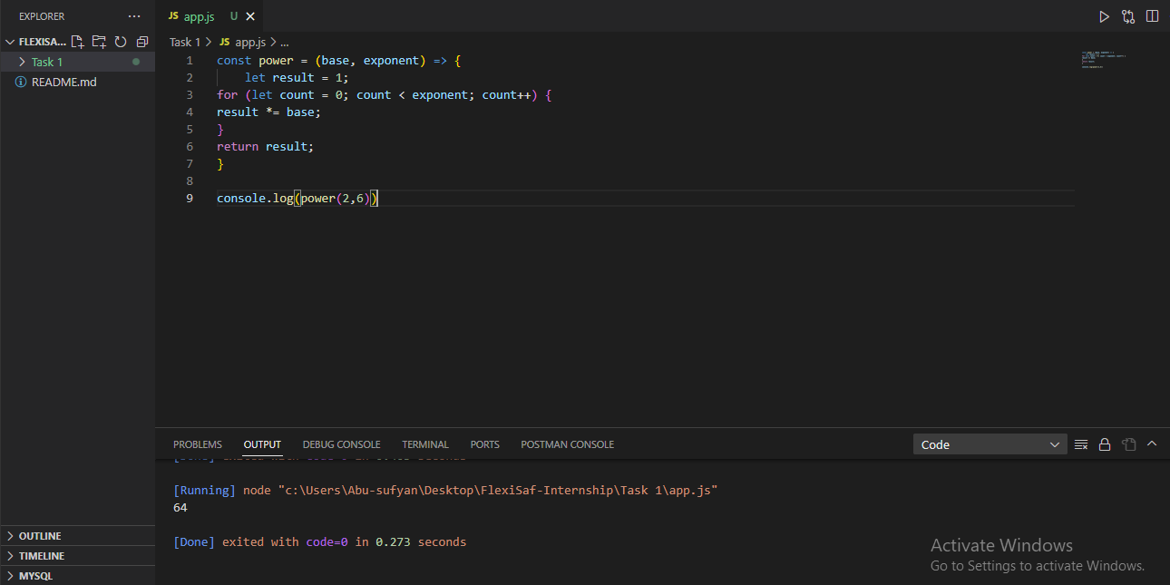
Arrow Function
ES6 Arrow functions provides alternative way to write a shorter function syntax.
Although shorter it has differences from the original function such as the not having bindings to this or super.

Slide 5
Arrays
An Array is an ordered list of values. Each value is called an element which is specified by an index.yntax
Const list = [item1,item2,item3,…]
Arrays has multiple methods
Filter
forEach
Map
reduce

Slide 6
Objects
An object is a collection of key value pairs. Each key-value pair is called a property.
Syntax
Let object = {
key: value,
}

Slide 7
Project
1. I built a mini restaurant ordering app that applies the concepts I learned from the studies.
2. I used an array of objects to store the data of the menu in order to apply the forEach array method.
I used an array (cart) is to push the selected item from the menu
I able to apply the knowledge from the deliverable to a single application that mirrors real life applications.

